Slide 1
Workforce Development Spotlight: March 2022 A Summary of Upcoming Career Compass and WFD Opportunities
New Content Coming Your Way!
The ECA to IDP Cycle
This year’s ECA to IDP Cycle opens 01 Mar! Taking the Employee Competency Assessment (ECA) is the first of four important steps associated with participating in the Career Compass program. Commanders and COs are asked to send an announcement email with additional details prior to the 01 Mar launch. More details: https://www.navfac.navy.mil/jobs/workforce-development/ccrc/emp_resources/eca.html
Live Webinars Coming This Month
Seven Ways to Build Your Influence at Work (Influencing and Negotiating; Awareness/Basic) – 15 & 17 Mar
https://www.navfac.navy.mil/jobs/workforce-development/ccrc/emp_resources/comp_dev_content/influencing-negotiating.html
SYSCOM Training Opportunities
NAVFAC’s annual Leadership Programs will be announced the week of 21 Mar, with an application period from 28 Mar – 27 May. More details: https://www.navfac.navy.mil/jobs/workforce-development/ccrc/emp_resources/leadership_dev_programs.html
Please see the following page for additional opportunities. The Career Compass Event Calendar has been updated to include all upcoming learning opportunities and trainings across SYSCOM. More details: https://www.navfac.navy.mil/jobs/workforce-development/ccrc/event-calendar.html
On-Demand Webinars and Resources Coming This Month
Influencing and Negotiating (early Mar)
Podcast: Six Steps for Preparing to Negotiate (Awareness/Basic)
Infographic: Three Dos and Don’ts to Build Your Influence (Awareness/Basic)
Job Aide: Five Ways to Influence More Effectively (Intermediate)
Job Aide: Preparing Your Negotiation Strategy (Advanced/Expert)
On-Demand Webinar: Improve Your Negotiation Skills (Advanced/Expert)
https://www.navfac.navy.mil/jobs/workforce-development/ccrc/emp_resources/comp_dev_content/influencing-negotiating.html
Continual Learning (mid-Mar)
On-Demand Webinar: Taking Charge of Your Learning and Development (Awareness/Basic)
https://www.navfac.navy.mil/jobs/workforce-development/ccrc/emp_resources/comp_dev_content/continual-learning.html
For additional details, please talk to your local Civilian Training Advocate (BD17).
*Note: If you are unable to copy and paste the links above, QR codes are available on the following page.

Slide 2
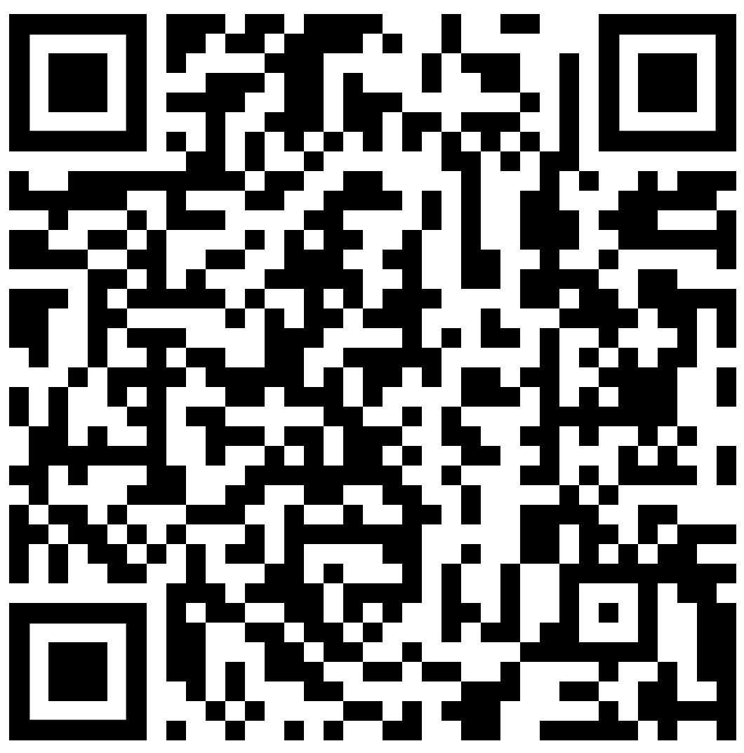
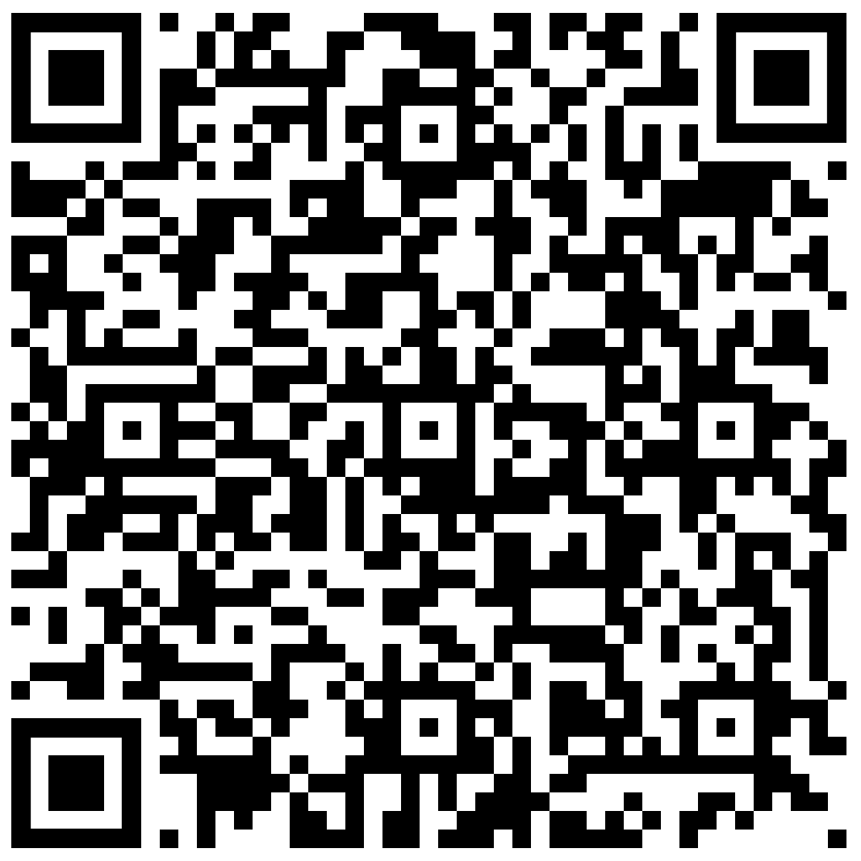
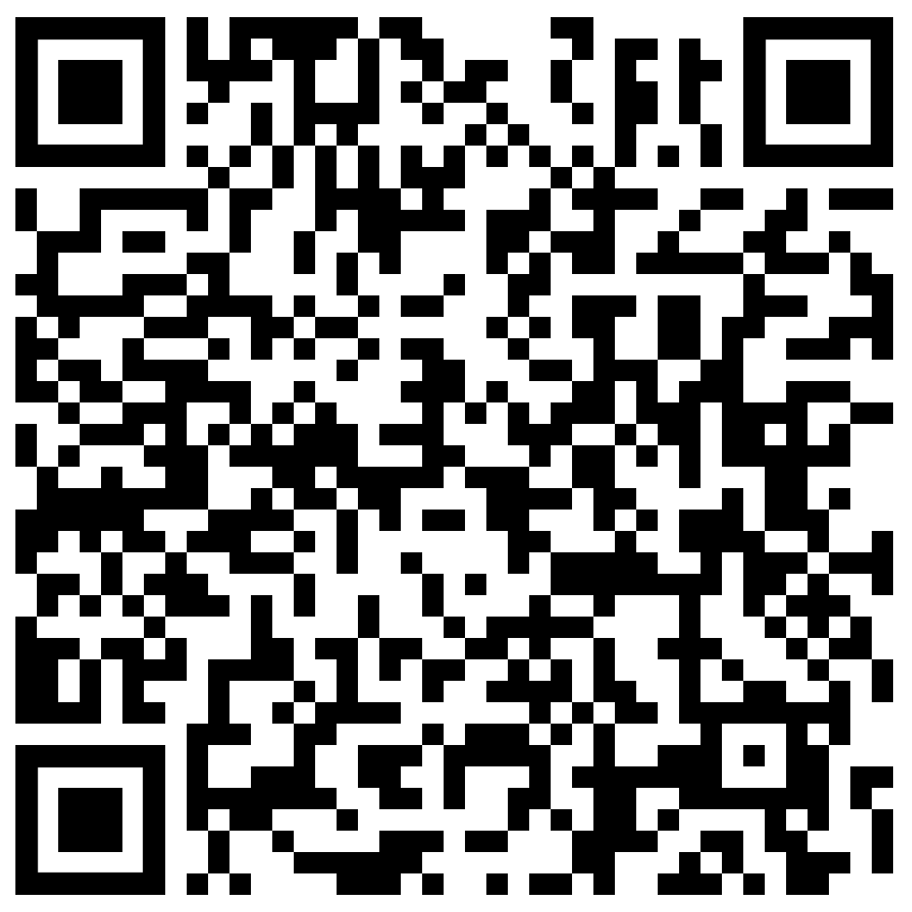
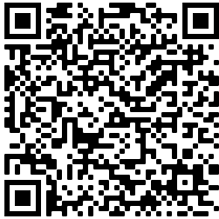
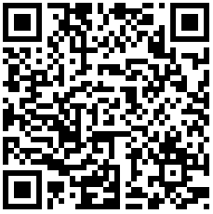
March SYSCOM Training Summary
The following QR codes can be used to access the pages referenced in the previous slide.
Start Date | Event
Mon, 14 Mar | NFI 201: Team Supervisors & Emerging Leaders (East)
Tue, 15 Mar | Live Webinar: Seven Ways to Build Your Influence at Work
Wed, 16 Mar | Communicating for Results (East)
Thu, 17 Mar | Live Webinar: Taking Charge of Your Learning and Development
Mon, 21 Mar | NFI 101: Fundamentals to Leadership (East)
Wed, 23 Mar | Communicating for Results (West)
Mon, 28 Mar | NFI 101: Fundamentals to Leadership (West)
Employee Competency Assessment (ECA)
Influencing & Negotiating Competency Page
April Courses Open for Registration
Start Date | Event | Registration Deadline
Mon, 04 Apr | Supervisor Academy: Current Supervisor Training, Cadre 3 | 01 Apr
Tue, 05 Apr | NFI 301: Leadership in Today's Navy (East) | Rolling
Tue, 12 Apr | Project & Program Management (West) | TBD
Thu, 14 Apr | Project & Program Management (East) | TBD
Mon, 18 Apr | NFI 201: Team Supervisors & Emerging Leaders (West) | Rolling
Wed, 20 Apr | Group Learning Program: Developing a Strategic Vision (Group 1) | 25 Mar
Thu, 21 Apr | Group Learning Program: Developing a Strategic Vision (Group 2) | 25 Mar
Tue, 26 Apr | NFI 301: Leadership in Today's Navy (West) | Rolling
Leadership Programs
Continual Learning
Competency Page
Career Compass Event Calendar

